Slide 1

TODD COUNTY MIDDLE SCHOOL
UPDATE ON INSTRUCTION

Slide 2
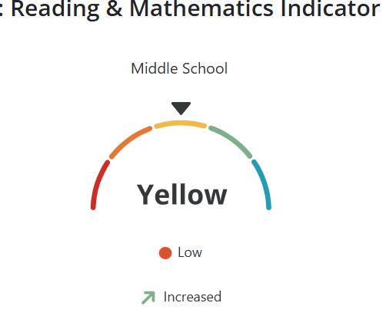
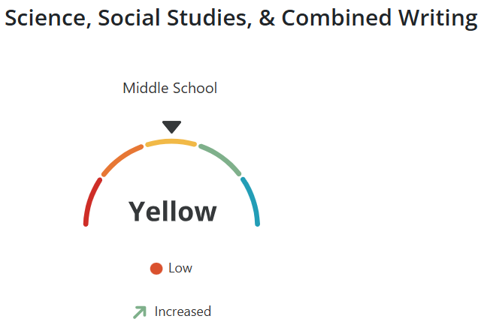
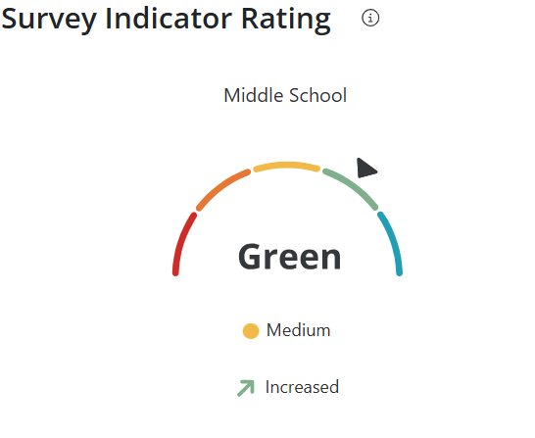
GROWTH

Slide 3
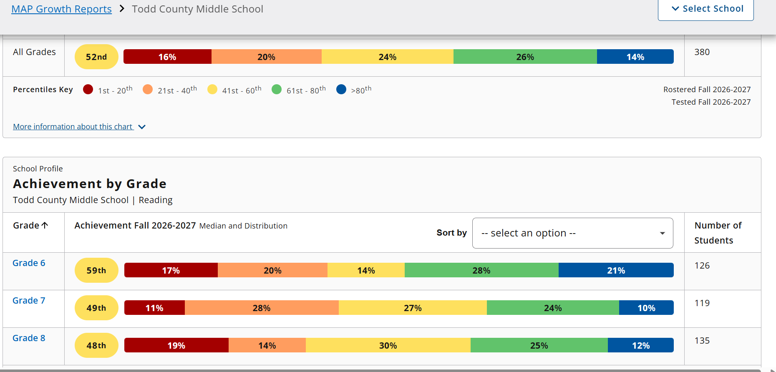
MAP READING

Slide 4
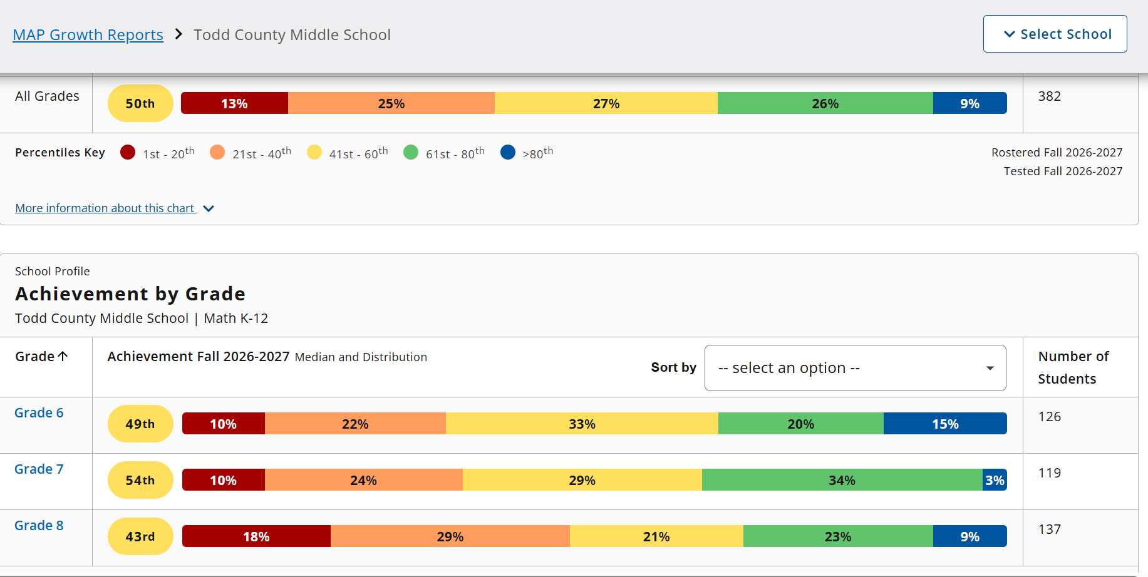
MAP MATH

Slide 5
INSTRUCTIONAL FOCUS
Vibrant Learning Co-Teaching Addressing TSI
  Staff awareness/training
  Administration training *
  Classroom walkthroughs *

Slide 6
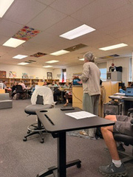
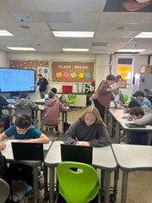
CO-TEACHING

Slide 7
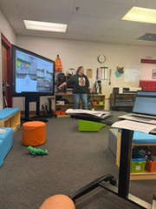
VIBRANT LEARNING
Represents powerful moments when learning is meaningful, engaging, and connected to real life. They move beyond traditional classroom instruction to spark curiosity, creativity, and collaboration—preparing students with the skills they need to thrive in school, work, and life.

Slide 8
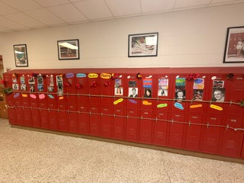
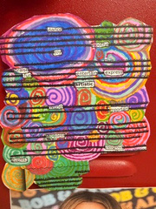
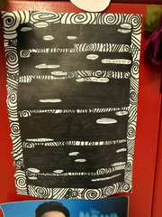
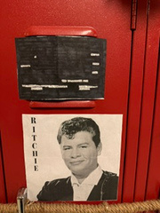
TIER 2 INSTRUCTION

Slide 9
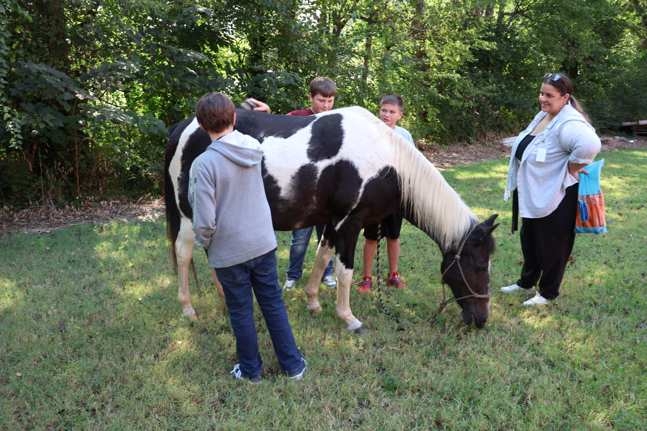
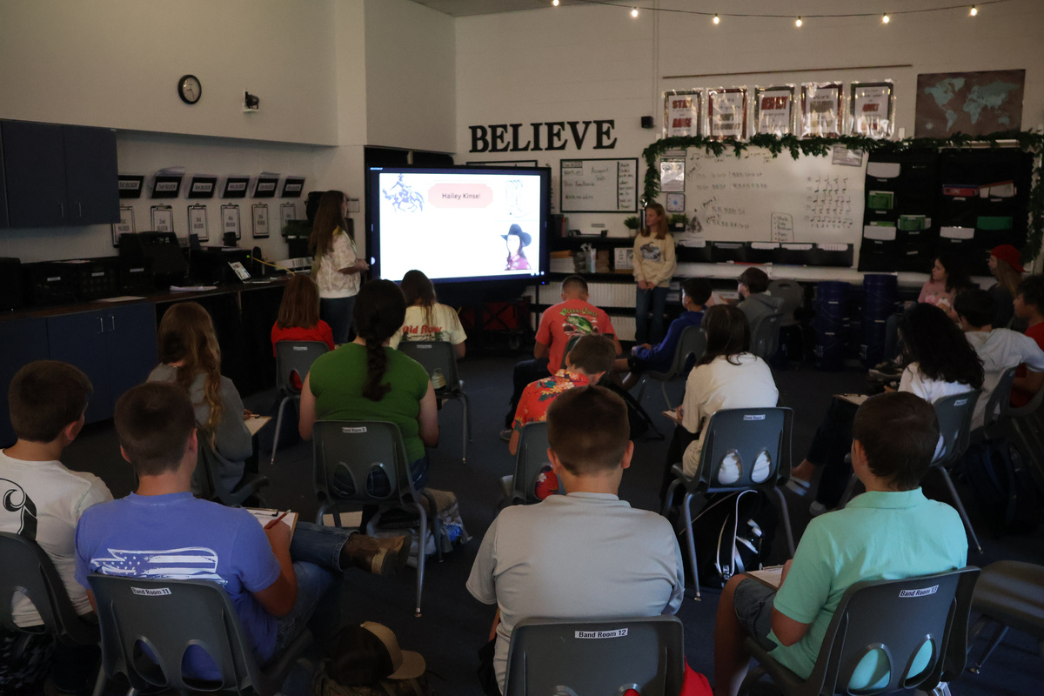
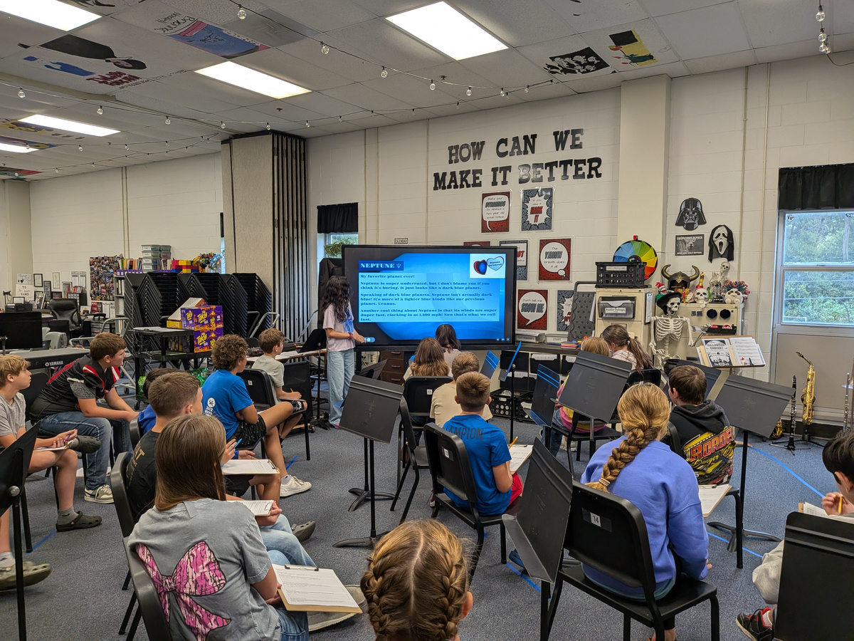
GENIUS HOUR
During the summer of 2026, Ms. Dipasquale obtained the teaching endorsement for gifted and talented. Through her studies and interest, the class “Genius Hour” was developed.

Slide 10

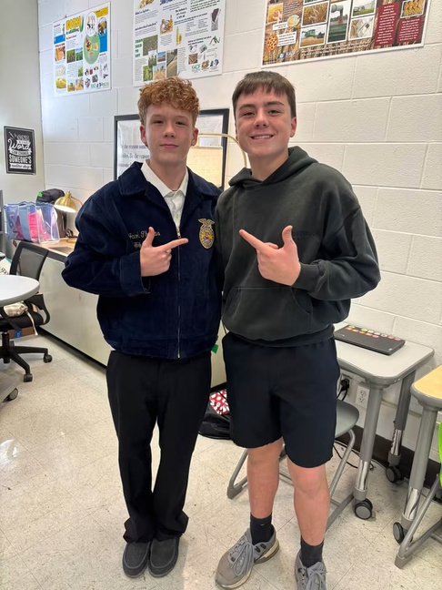
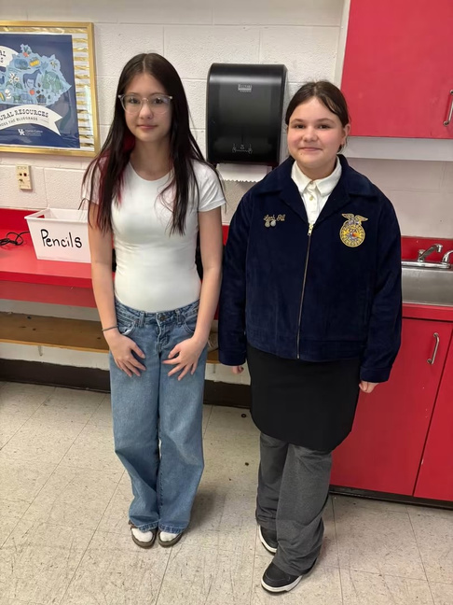
TCMS FFA
On October 15th, 2026 Todd County Middle School was officially chartered with the National FFA Organization.

Slide 11
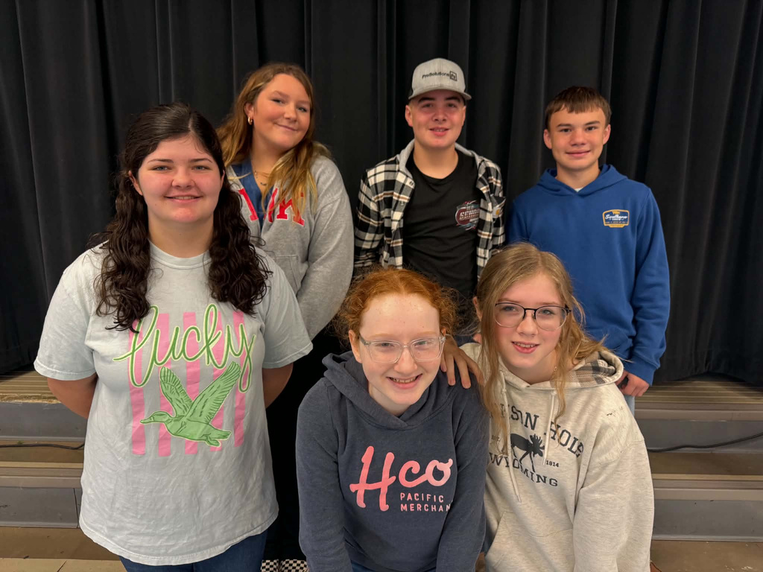
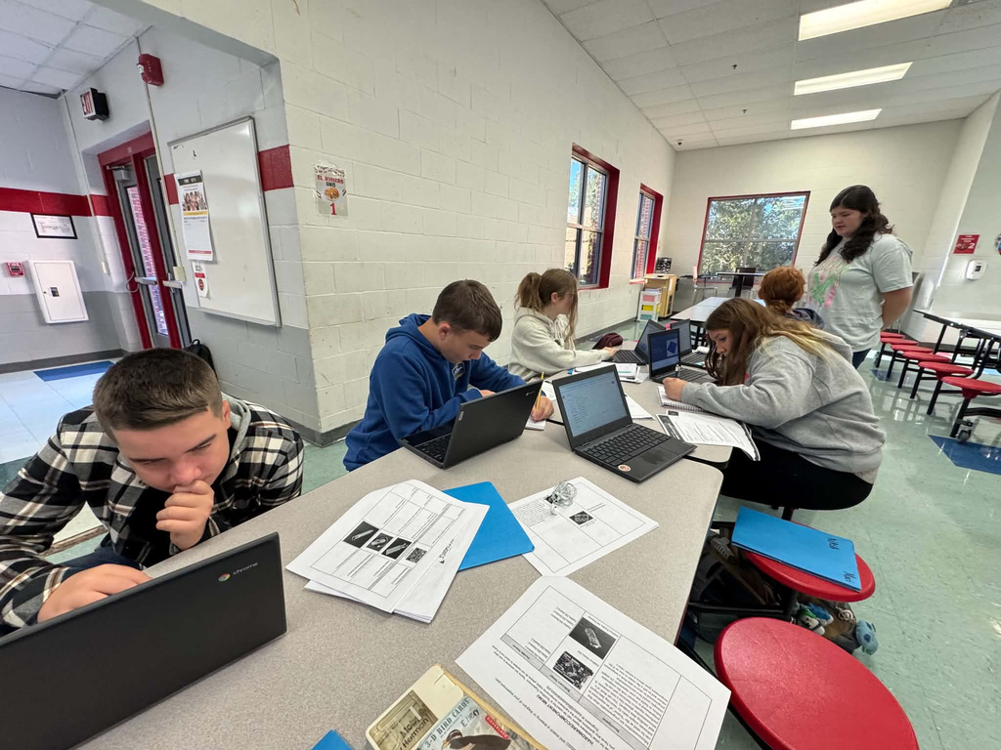
TECH RISE
Tech Rise is a nationwide competition sponsored by NASA. Students from grades 6-12 propose science or technology experiments for a NASA sponsored flight. The TCMS team began with an interest from one student, with support from her parents (who volunteered), and grew into a student led group representing grades 6-8. This group worked on an experiment to test on a high altitude balloon.

Slide 12
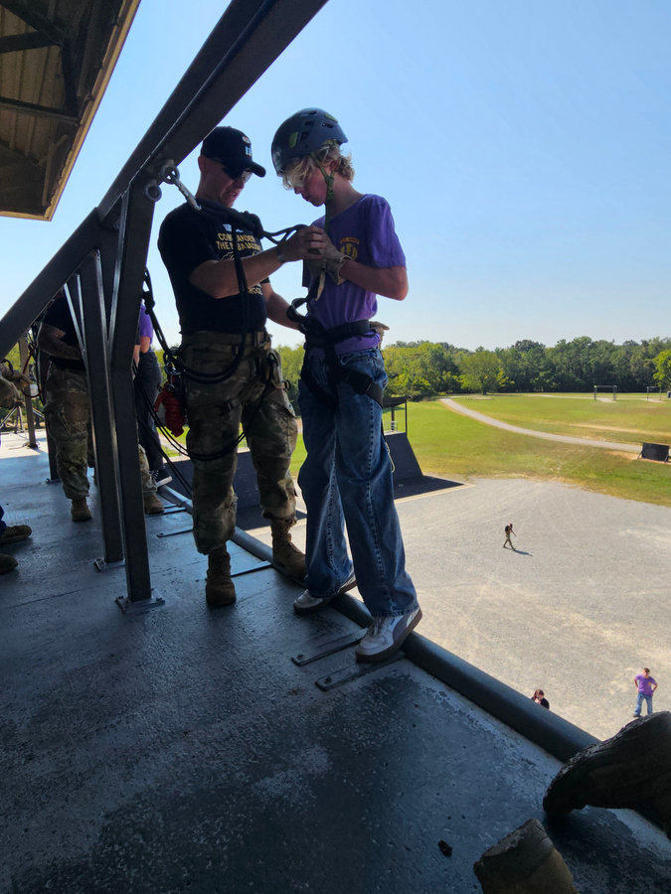
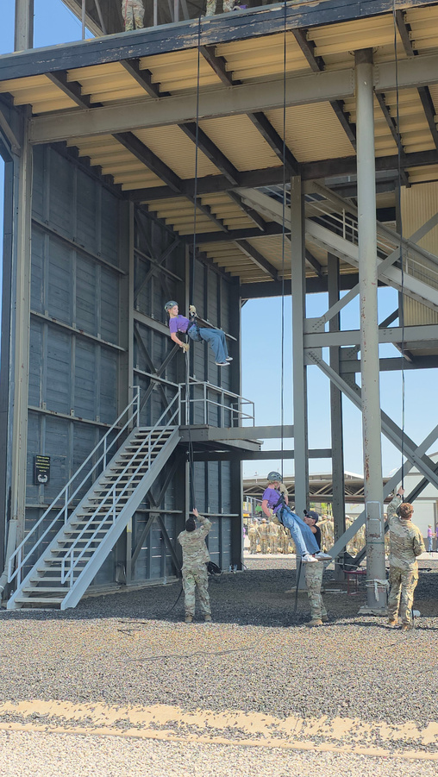
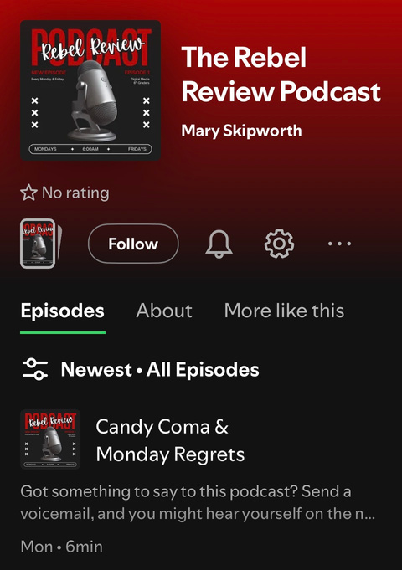
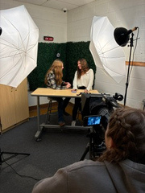
JROTC
DIGITAL MEDIA
JROTC continues to grow. This year 24 students requested to be in the program. The cadets are learning leadership skills and community service among other skills. The TCMS Digital Media class continues to grow and has added a podcast that can be heard on Spotify! The Rebel T broadcast continues and students are learning how to create, edit, and produce relevant topics to their peers.

